Slide 1
Brain Derived Neurotrophic Factor as a Necessary Component to Reverse Motor Deficits in Animal Models of Parkinson’s Disease
Marie Severson

Slide 2
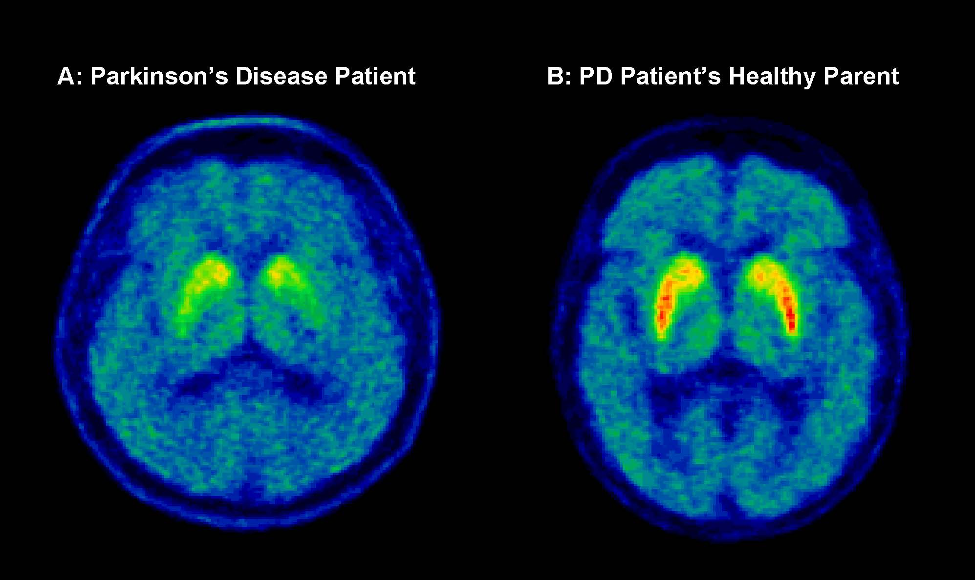
Background:
Parkinson’s Disease (PD)
Neurodegenerative disorder
Loss of Dopaminergic neurons in Substantia Nigra
https://www.triumf.ca/galleries/image/66-pet-scan
Notes:
PD- chronic and progressive, irreversible, no cure
Shows PD brain with virtually no functioning Dopaminergic neurons left B. shows healthy brain
The loss of dopaminergic neurons/ production of DA leads to motor impairment.

Slide 3
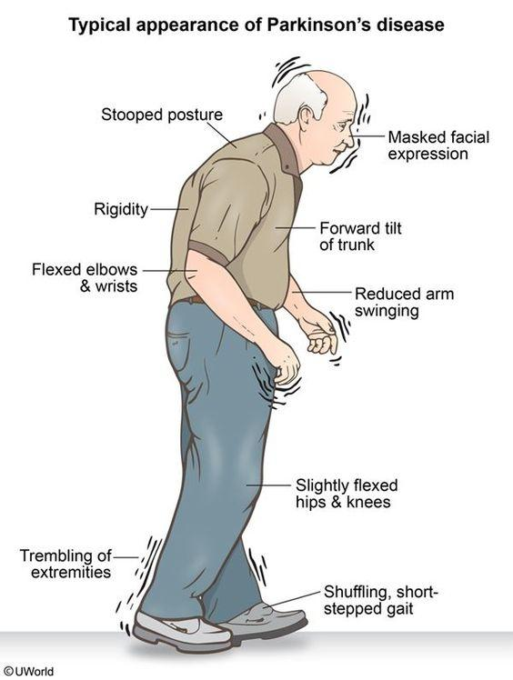
    Motor Deficits
      Rigidity
      Resting tremor
      Bradykinesia
      Postural instability
      Gait impairment
      60-80% loss of DAergic neurons
Notes:
Rigidity- increased muscle stiffness
Resting tremor- when limb is at rest, tremors are present. When limb moves with intention, the tremors cease.
Bradykinesia- slowness of movement
Postural instability- stooped posture and balance issues
Gait impairment- shuffling of feet when walking
60-80% of dopaminergic neurons from striatum or putamen are lost before motor impairments are observed

Slide 4
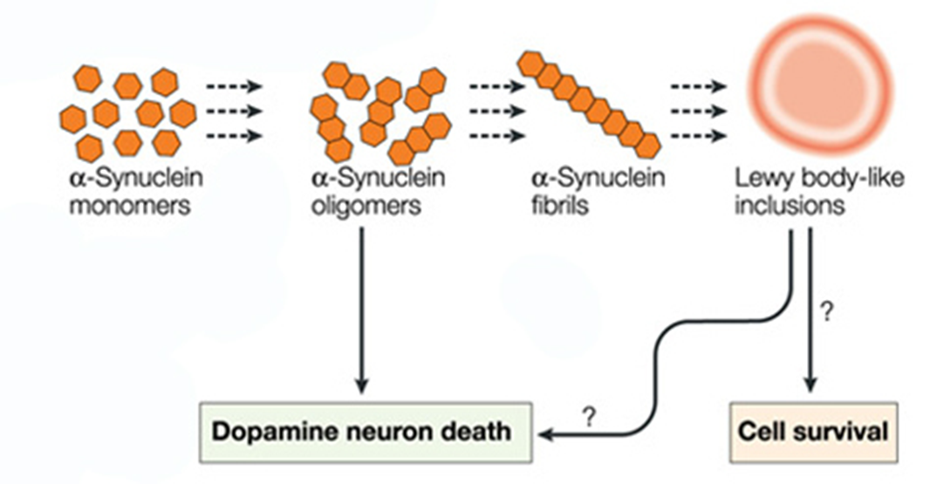
  Presence of Lewy Bodies
    Alpha-synuclein (α-syn) aggregates
https://www.nature.com/articles/nrn1199
Notes:
Lewy bodies are aggregates of misfolded protein alpha-synuclein. α-syn is a protein found in the presynaptic nerve terminal and is expressed through out the central nervous system.
When in it’s oligomeric state, α-syn causes cytotoxicity in recipient cells, which leads to a host of issues including mitochondrial dysfunction, oxidative stress and disruption of plasma membrane and pore formation that eventually leads to cell death.
If Lewy bodies are formed, the cell can either die or the LBs can spread to another cell.

Slide 5
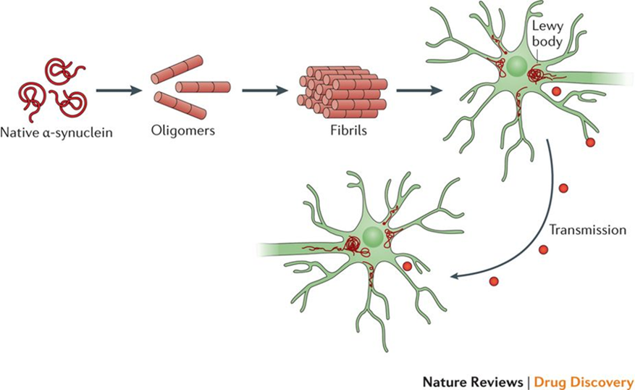
https://www.nature.com/articles/nrd.2017.95/figures/1
Notes:
α-synuclein has the ability to be transmitted from cell to cell using a variety of mechanisms such as endocytosis, plasma membrane penetration or through exosomes.

Slide 6
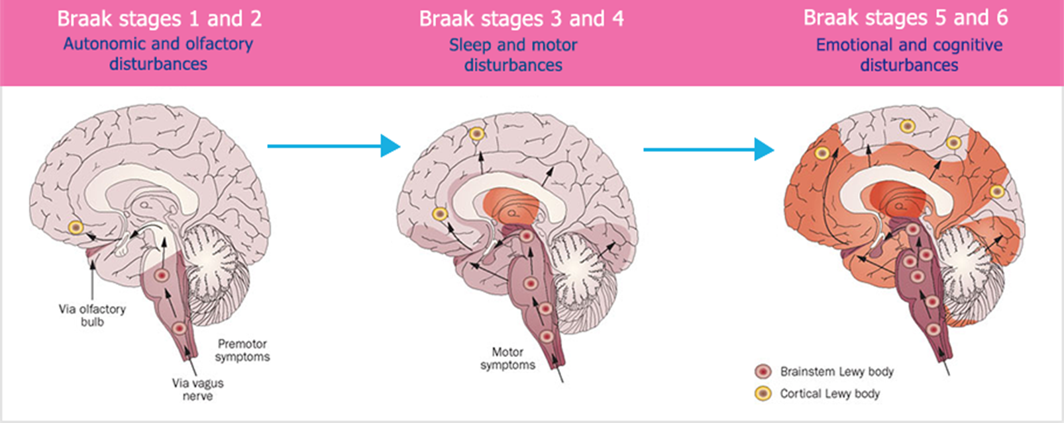

Slide 7
Over 1.3 Americans are affected by PD with Lewy body dementia (DLB)
DLB is second most prevalent form of dementia
Treatment is limited
Notes:
Second form of dementia to Alzheimer’s
Pharmacological interventions- L-Dopa is first but eventually becomes ineffective
Alpha-syn aggregates form in the cortex, hippocampus and brainstem impacting cognition, 70% of PD patients get PDD- closely related to DLB

Slide 8
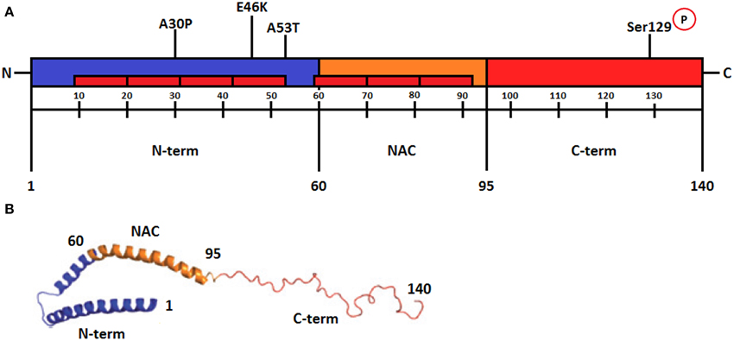
Alpha-synuclein Aggregation
Point Mutations
Gallegos et.al, Frontiers in Neuroscience, 2015
Notes:
A30P, E46K and A53T are the locations where α-syn mutates and is prone to aggregation.
N-term (amino terminal)- amino acids 1–60 is the region responsible for α-syn membrane interactions.
NAC (non-β amyloid component)- amino acids 61-95 is the most hydrophobic region and is required for aggregation. This region folds and forms amyloid fibrils.
C-terminal- amino acids 96–140 consists of acidic residues and negative charges. The residue serine129 is phosphorylated in Lewy bodies and this location is used as a marker for α-syn aggregation.

Slide 9
Niu et.al.
1. Will overexpression of human-α-synuclein (hm-α-syn) in the olfactory bulb (OB) spread to other brain areas?
2.Does α-syn aggregation affect synaptic connectivity in the OB?
3. How does α-syn aggregation affect dopaminergic neurons?

Slide 10
Methods:
Viral vector used to overexpress hm-α-syn in 12 month old Sprague Dawley rats
AAV 1/2
CMV
syn
(A30P A53T)
ires
GFP
Different AAV serotype used as control
AAV 2/1
CVM
GFP
Notes:
Adeno associated virus serotype ½- viral vector
Cytomegalovirus- early promoter
human alpha-synuclein, (protein of interest) overexpresses at point mutations A30P and A53T
internal ribosomal entry site
Green Fluorescent Protein- reporter protein

Slide 11
Methods:
Retrograde tracing to detect monosynaptic connections beyond OB
  Rabies Virus was injected into the OB at the same coordinates as the hm-α-syn overexpression
      AAV9-EF1a-Dio-GFP-TVA
      AAV9-EF1a-Dio-RV-G
Notes:
Rabies virus was used to determine if alpha-syn overexpression traveled beyond the OB
These two were combined 1:1

Slide 12
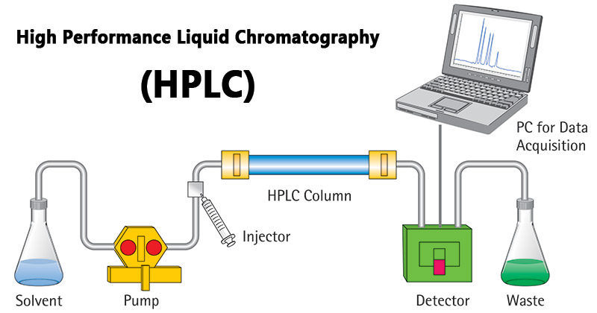
Methods:
Striatal catecholamine quantification

Slide 13
Methods:
Behavioral Tests
Odor discrimination
    Assess olfactory function (sniffing behaviors)
      Tested threshold (lemon in mineral oil)
      Established ‘sniff behavior’
      Exposed to rose odor for habituation (familiar)
      Exposed to lemon odor for dishabituation (novel)
Notes:
Presented increasing concentrations of lemon in mineral oil to test the odor response by observing sniffing behaviors.
Then they added a different liquid on a swab. When the animal was close to the swab with its nose, they called it a sniff behavior.
Then, they were cross-habituated to measure non-associative memory (were they habituated or sensitized?). Each odor (rose, lemon) was dropped onto a swab, and the number of sniffs each animal made was recorded.
First, animals were exposed to rose (familiar) in 5 consecutive trails, 3 min each for the habituating process. Then they were exposed once for 3 min to the novel odor (lemon) for dishabituation.
The olfactory function was measured by the number of times the rats sniffed the swab.

Slide 14
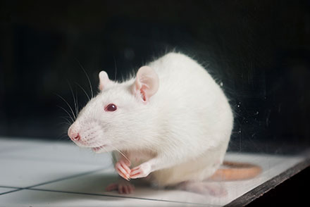
Methods:
  Open field test
    Square area (45x45x40cm)
    Allowed to explore area before test
    Distance traveled and # of times center line was crossed were measured

Slide 15
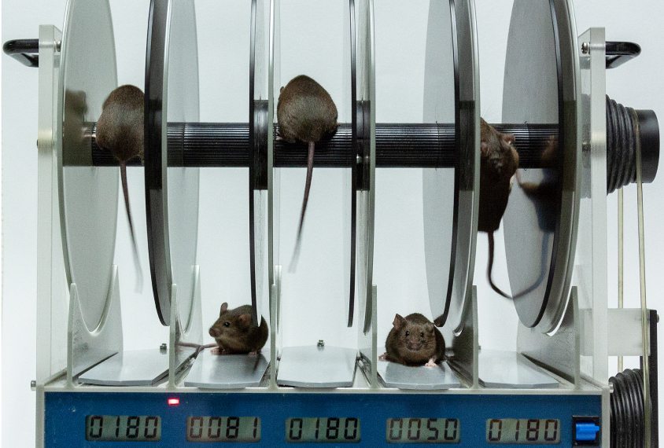
Methods:
Rotarod test
  Measured coordination of alpha-syn rats
  Mean time spent on the rod was measured
Notes:
Trained to stay on rod until the cut off time (10 cycles per min for 3 min). Began stationary, then slowly increased speed of wheel by 10 rpm every 20s until they fell off.

Slide 16
Methods:
Microscopy and various staining methods
Immunohistochemistry/ immuno-fluorescence
    Green Fluorescent Protein labeling
      Trace α-syn projections and aggregation outside OB

Slide 17
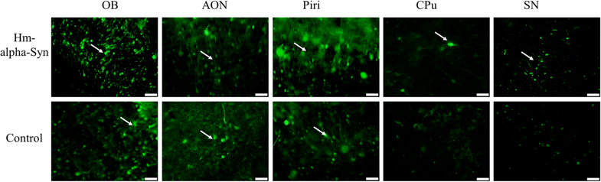
Results/ Discussion:
Hm-α-syn was detected outside OB 3 wks after AAV injection
  Only hm-α-syn-GFP was found outside OB
Notes:
Fig. 2
Olfactory Bulb, the Anterior Olfactory Nucleus, the PrePeriform Cortex, the Caudate Putamen, and the Substantia Nigra are shown.
No GFP signal was found in the SN in the control animals.
Both the hm-α-Syn-GFP and the control GFP were expressed in the olfactory fields by the AAV, but only the hm-α-Syn-GFP was transferred to the adjacent brain regions.

Slide 18
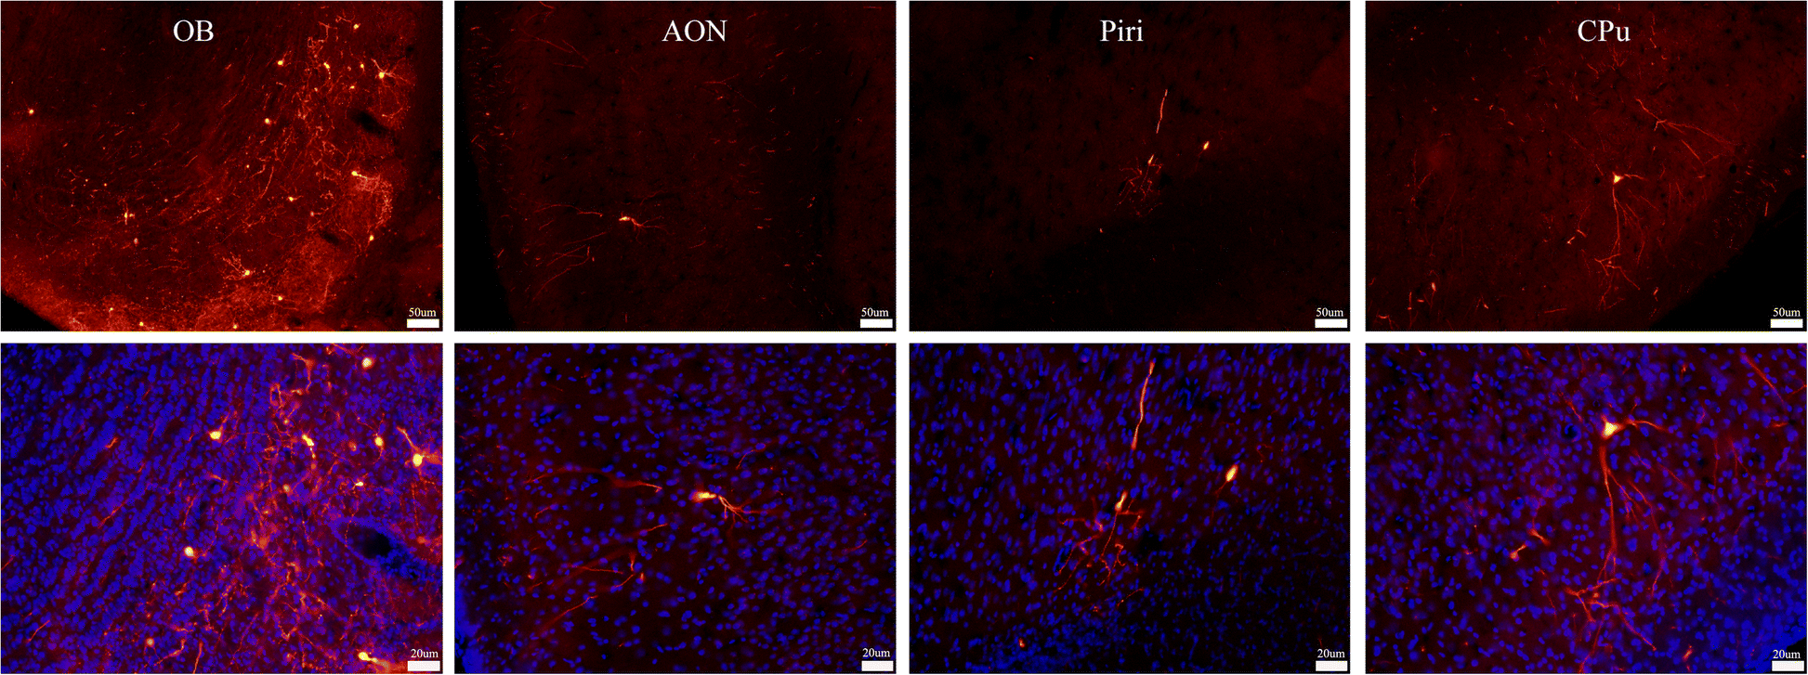
Results/ Discussion:
Rabies Virus was not detected in Substantia Nigra
Notes:
Fig. 3
Representative retrograde labeling in brain regions following RV infection in the OB. Signals from RV were detected in α-syn-positive fields including the Olfactory Bulb, the Anterior Olfactory Nucleus, the PrePeriform Cortex, and the Caudate Putamen 3 weeks after the AAV injection.
No projections from the SN were found

Slide 19
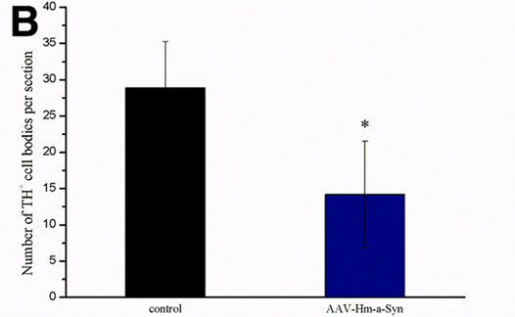
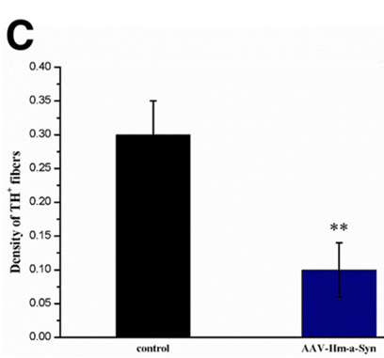
Results/ Discussion:
Tyrosine Hydroxylase is reduced in SN (cell bodies) and striatum (fibers) 12 weeks post injection
Notes:
Fig. 4
Effect of AAV-hm-α-syn injection on the number of dopaminergic neurons and DA levels in the striatum-SN.
b. Tyrosine Hydroxylase (TH) positive cells in the SN
c. Density of TH positive fibers in the striatum 12 weeks after injection into the OB.
These results indicate that the number of TH-positive cells bodies and terminals in the SN-striatum fields is reduced 12 weeks after AAV-hm-α-syn injection.

Slide 20

Results/ Discussion:
Reduced DA and DOPAC in Substantia Nigra
12 wks after AAV-hm-α-syn injection
Notes:
Fig. 4
d & e) Comparison of DA and DOPAC level in the striatum. These results indicate that DA and DOPAC level in the SN-striatum fields is reduced 12 weeks after AAV-hm-α-syn injection.

Slide 21
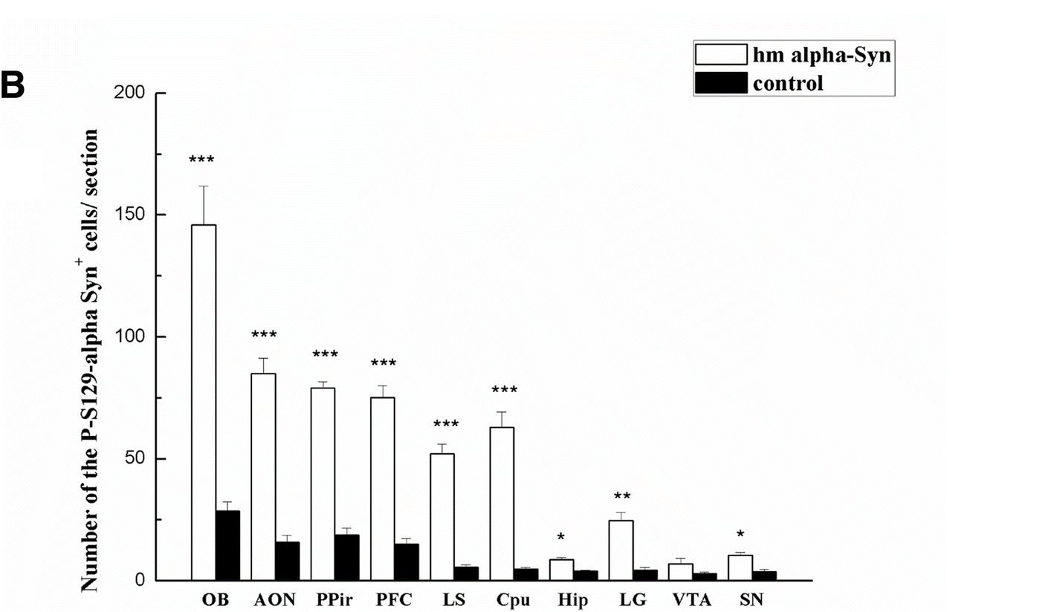
Results/ Discussion:
Notes:
Fig. 5
b. Comparing the number of the pSer129 α-syn+ cells between the experimental and control animals.
Phosphorylation is necessary for aggregates to form.

Slide 22
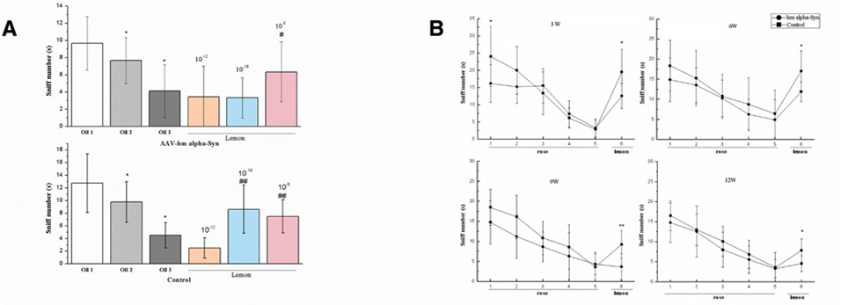
Results/ Discussion:
Rats overexpressing hm-α-syn demonstrate olfactory impairment
Notes:
Fig. 6
Rats injected with the AAV-hm-α-syn exhibit progressive impairment in odor discrimination and motor behaviors. a Animals were exposed to the 10− 8 rose odor for consecutive trials (habituation) and then exposed to increasing concentrations of lemon in mineral oil (10− 12, 10–10, or 10− 8 unit) for three consecutive trials (dishabituation) to test the response threshold after the AAV injection. # means a significant difference (p < 0.05) contrasted with the last test in the habituation (oil 3). b Results of the odor habituation/dishabituation test. After the habituation trials for sniffing rose odor, rats showed impaired odor habituation/dishabituation behavior 3 weeks after AAV-hm-α-syn injection than control.

Slide 23
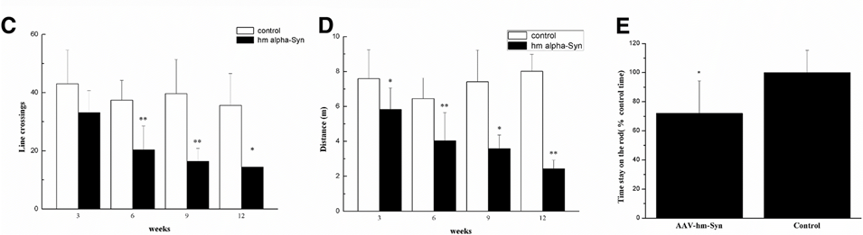
Results/ Discussion:
Rats overexpressing α-syn have reduced locomotion
Time spent on the rod is lower in alpha-syn rats than control 12 wks after AAV injection
Notes:
Also, 6, 9 and 12 weeks after the AAV-hm-α-syn injection (c and d) in the OB, locomotion in the open field was reduced. The number of times crossing the line and the total distance traveled were lower 6 weeks after the AAV-hm-α-syn injection. The rod test showed that 12 weeks after AAV hm-α-Syn injection in the OB, the rats had decreased the amount of time they stayed on the rod relative to control treatment. Latency time 12 weeks after AAV injection of OB.

Slide 24
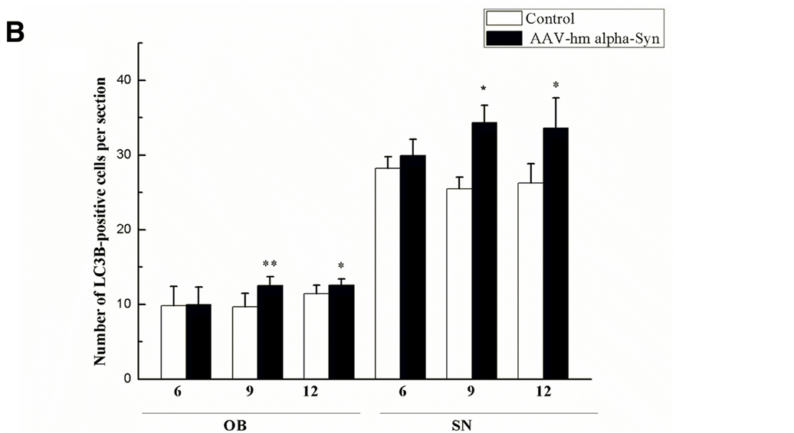
Results/ Discussion:
Notes:
Fig. 8
(b) These results indicated that the number of LC3B-positive cells (marker for autophagosomes) in the OB and SN field was enhanced 6weeks to 12 weeks after the AAV-hm-α-syn injection.

Slide 25
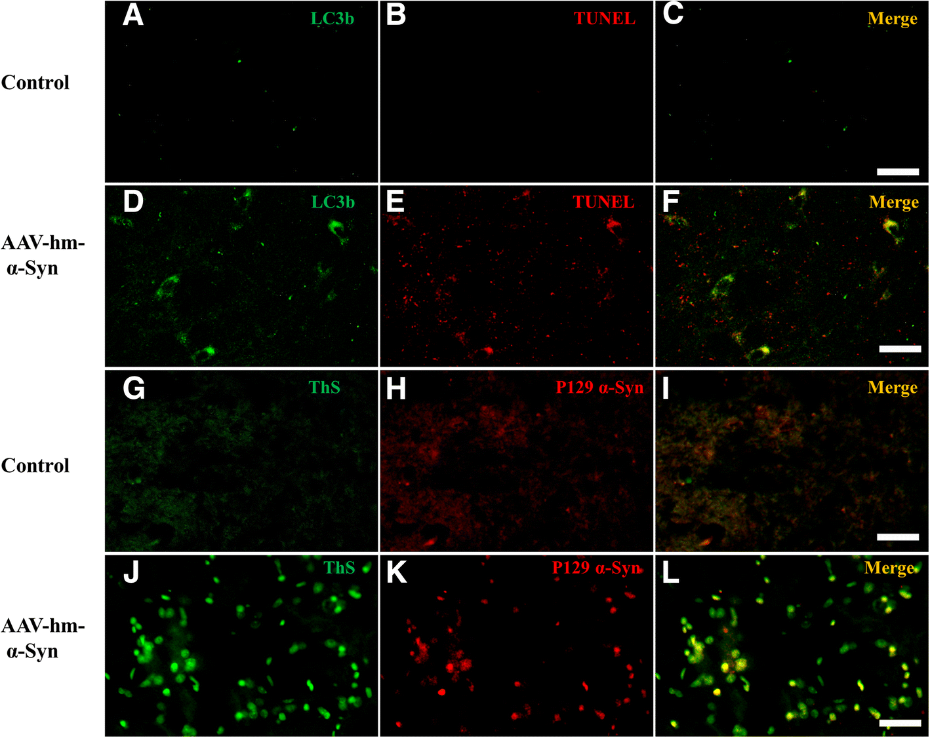
Results/ Discussion:
Notes:
Fig. 10
Immunofluorescent double-labeled staining in the SN field. Thioflavin-S- positive marker for Lewy Bodies
a-c. double staining of SN field by LC3B (green) and TUNEL staining (red) in the control rats.
d-f. double staining of SN field by LC3B (green) and TUNEL staining (red) in the hm-α-synuclein rats. These data indicates that the apoptosis happen in some cells overexpressing the hm-α-synuclein.
g-i. double staining of SN field by ThS (green) and pSer129-α-synuclein staining (red) in the control rats.
j-l. double staining of SN field by ThS (green) and pSer129-α-synuclein staining (red) in the hm-α-synuclein rats. These data indicates that pSer129-α-synuclein signals reflected LB pathological changes. Neurons are dying.

Slide 26
Conclusions:
This study presents a promising model to develop more effective treatment and earlier diagnosis. Over-expression of α-syn in the olfactory bulb spreads to adjacent brain areas, causing pre-motor symptoms of PD. The spread of alpha-synuclein to other brain areas hinders autophagy and increases apoptosis, leading to loss of dopaminergic cell death.

Slide 27
Razgado-Hernandez, et. al.
Does Brain Derived Neurotrophic Factor (BDNF) amplify the regeneration of nigrostriatal innervation of dopamine by activating D3 receptors?

Slide 28
Methods:
12 month old Wistar rats were lesioned with 6-OHDA in the striatum to produce symptoms of PD.
Administered the D3 agonist 7-OH-DPAT over 4 ½ months, beginning at 17 months of age.
Notes:
6-hydroxydopamine hydrochloride- neurotoxic compound used to destroy dopaminergic neurons, thus mimicking symptoms of PD.
7-hydroxy-N,N-di-n-propyl 1-2-aminotetralin

Slide 29
Methods:
Non-viral nanovector Neurotensin-polyplex was used to transfect phDAT-BDNF-flag into dopamine neurons
NTS-polyplex
phDAT
BDNF-flag
Notes:
Injected at the start of the D3 agonist infusion

Slide 30
Methods:
Gait analysis
Rotarod test
Immunohistochemistry/ immunofluorescence
Optical densitometry

Slide 31
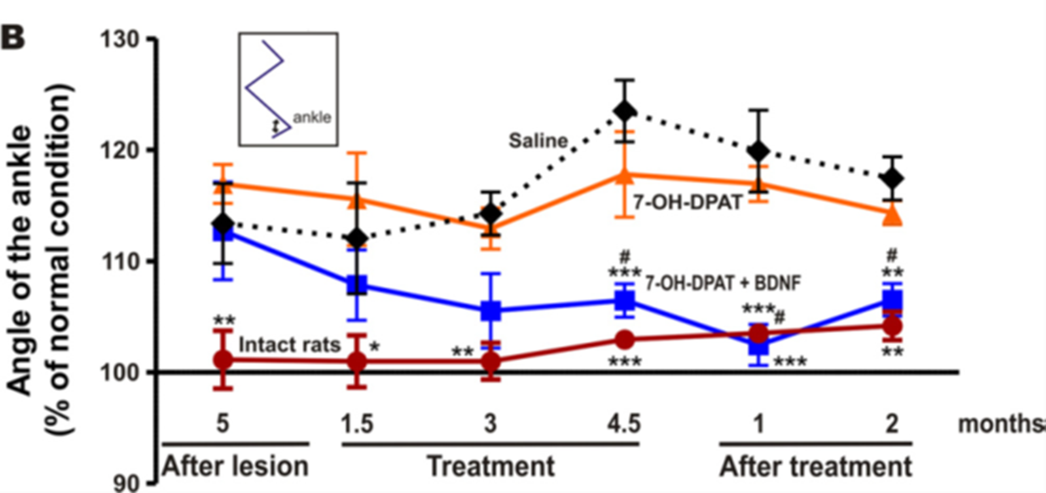
Results/ Discussion:
Normal gait was recovered in rats treated with both D3 agonist and BDNF
Notes:
Fig 2.
The combined treatment restored gait.
A. The lesion increased the angle of the contralateral ankle during the dorsiflexion of the swing phase of gait (arrows)
The combined treatment normalized both conditions (A, B).
The D3 agonist alone did not restore the angle of the ankle during gait.
B. The recovery produced by the combined treatment was significant compared with saline-treated rats. No significant difference compared with intact rats.

Slide 32
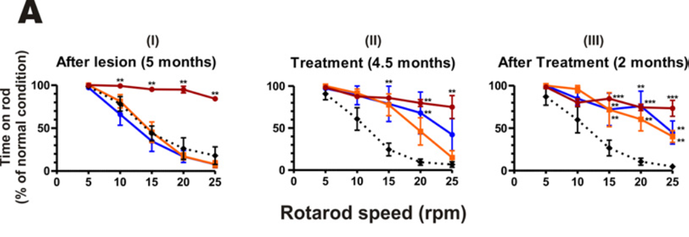
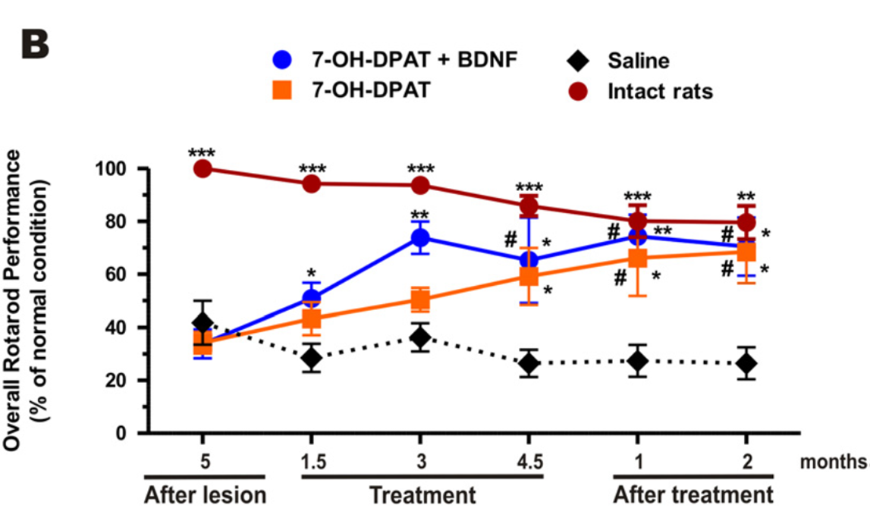
Results/Discussion:
Lesioned rats had reduced performance and time spent on the rod.
Rats treated with 7-OH-DPAT + BDNF recovered motor coordination.
Notes:
Fig 3.
D3 agonist with the BDNF transfection restored motor coordination.
The lesion reduced the time on the rod and the rotarod performance
(A). The combined treatment normalized the time on the rod (A-II) and the rotarod performance
(B). The effect persisted two months after the treatment (A-III and B). The D3 agonist alone also recovered the motor coordination (A, B) but the rats dragged the contralateral hind limb during rod rotation.
The recovery produced by the treatments were significant compared with saline-treated rats. No significant difference compared with intact rats.

Slide 33
Results/ Discussion:
DA neurons were restored in the rats treated with D3 agonist + BDNF
Notes:
Fig 7.
The combined treatment restored the number of dopamine neurons of the subtantia nigra pars compacta.
Representative microgaphs of TH-immunoreactivity in mesencehalon slices.
micrographs in A showing that the combined treatment recovered the dopamine dendrites, judged by the overlapping of the lesion side histogram (red) with the normal side histogram (black).
P< 0.01 compared with the 7-OH-DPAT alone

Slide 34
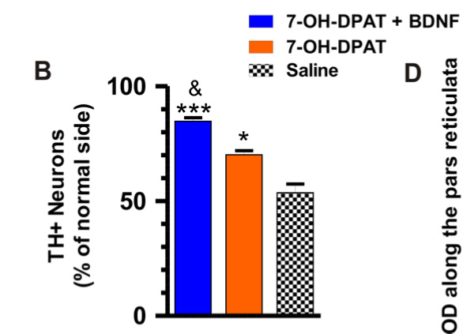
Results/ Discussion:
TH+ neurons were restored significantly in the SN
Notes:
(B) Number of TH+ neurons along the rostro-caudal extension of the susbtantia nigra pars compacta.

Slide 35
Conclusions:
Persistent, extended administration of 7-OH-DPAT + BDNF recovers motor coordination to pre-lesion levels and approximately 80% of DA neurons were restored in the SN.
The D3 agonist alone was not enough, BDNF is required for significant recovery.

Slide 36
Goldberg et.al, 2015
1. Will increasing the level of BDNF expressed in transplanted neural stem cells (NSC) improve motor and cognitive function?
2. Is BDNF necessary for NSC to recover motor and cognitive function?

Slide 37
Methods:
12 month old α-syn overexpressing (ASO) mice and Wild Type (WT) were randomly assigned to a treatment group
Injected with either NSCs or vehicle. (ASOC, ASOV)
New cohort (12 m) was injected with either NSC or BDNF shRNA knockdown NSC (BKC)
    Same tests were performed
Notes:
Tx groups- the dorsal and ventral medial striatum.
Bred mice to overexpress alpha-syn

Slide 38
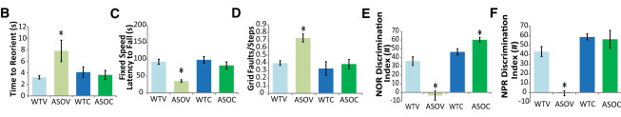
Results/ Discussion:
NSC transplantation recovers motor and cognitive function in ASO mice
Notes:
Figure 1
Wild type vehicle
Alpha-synuclein overexpressing vehicle
Wild type NSC
Alpha-synuclein overexpressing NSC
NSC Transplantation Improves Both Motor and Cognitive Function in α-Synuclein Transgenic Mice
(B–D) ASO vehicle treated controls (ASOV) show deficits in Pole reorientation
(B), Rotarod performance
(C), and beam traversal
(D) tasks, which were significantly ameliorated by NSC transplantation (ASOC).
(E and F) ASOV mice also showed significant deficits in cortical-dependent Novel Object Recognition
(E) and hippocampal-dependent Novel Place Recognition (F), which were improved by NSC transplantation (ASOC).

Slide 39
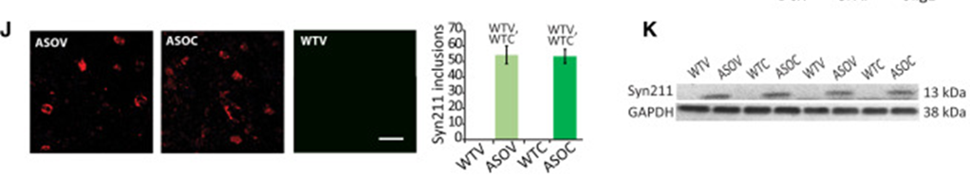
Results/ Discussion:
There is no difference in number of α-syn inclusions in the striatum between ASOV and ASOC mice
Western analysis shows NSC have no effect on striatal α-syn
Notes:
Fig.1
(J) no differences in either striatal h-α-syn inclusion number between ASOV and ASOC mice, and no differences were detected in WT mice.
(K) Western blot analysis of striatal monomeric h-α-syn (Syn211) was not significantly altered by NSCs.

Slide 40
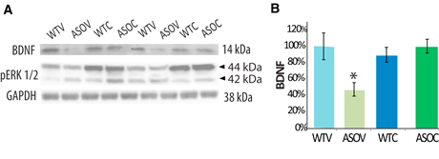
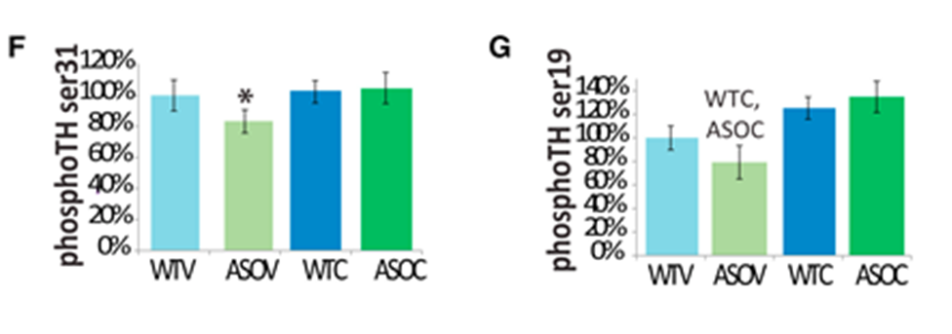
Results/ Discussion:
BDNF in striatum was significantly decreased in mice overexpressing alpha-synuclein/ vehicle
NSC transplantation in ASO mice restored BDNF to wild-type levels
Phosphorylation of TH+ at p-ser31 and p-ser19 was significantly decreased in ASOV mice and increased in ASOC mice.
Notes:
Figure 2.
NSC Transplantation Enhances Striatal BDNF Signaling
(A and B) Western blots revealed that striatal BDNF was significantly decreased in ASOV mice but restored to WT levels by NSC transplantation.
(F and G) Activated forms of TH (p-ser31 and p-ser19) were significantly decreased in ASOV mice and elevated by transplantation.

Slide 41
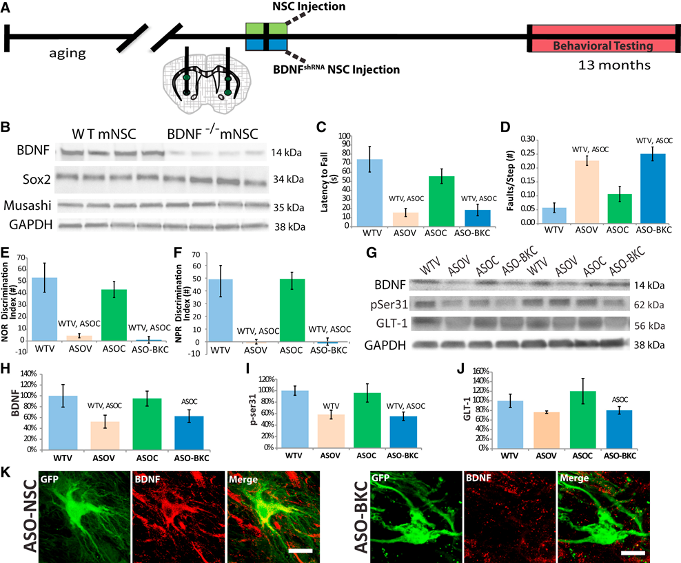
Results/ Discussion:
Knockdown of BDNF shows it is necessary for NSC to rescue motor and cognitive performance
Notes:
Figure 5.
BDNF is Necessary for NSCs to rescue Motor and Cognitive performance
(B) A new cohort of ASO and WT mice aged to 12 months were injected bilaterally with either NSCs or BDNF shRNA knockdown NSCs (BKCs).
NSC BDNF expression was reduced 84% by shRNA in BKCs and multipotency was not affected by BDNF knockdown as measured by Sox2 and Musashi expression (B; n = 6 biological replicates).
(C and D) After four weeks, transplantation of BDNFshRNA -NSCs into ASO mice failed to improve either Rotarod (C) or beam traversal performance (D).
(E and F) Similarly, NSC-derived BDNF was critical for NSC-mediated improvements in cognitive function in NOR and NPR tasks in ASO mice (D–F).

Slide 42
Results/ Discussion:
Striatal BDNF was not increased in ASO-BKC mice
Striatal TH+ p-ser31 was not significantly increased in ASO-BKC mice
Notes:
Figure 5.
BDNF Is Necessary for NSC-Induced Motor and Cognitive Rescue
(G–I) As in the ASOV group, striatal BDNF was not increased in ASO-BKC mice
(G and H). BDNFshRNA -NSCs were also unable to significantly increase striatal TH ser31 (G, I).

Slide 43
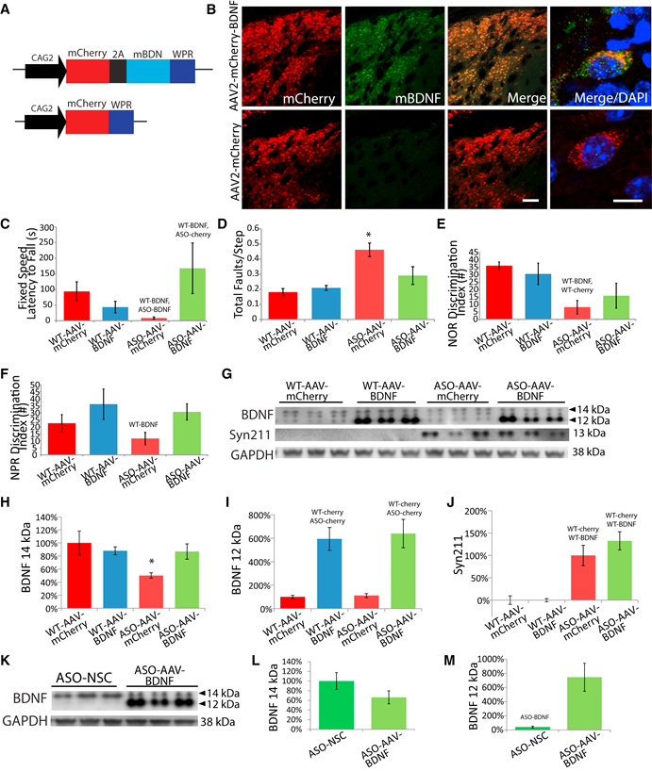
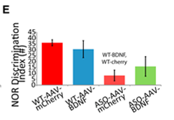
Results/ Discussion:
Viral delivery of BDNF with no NSC provides recovery of motor performance
Cognitive improvement with BDNF and no NSC was not significant
Notes:
Figure 6.
Viral Delivery of BDNF Partially Mimics the Effects of NSCs on Motor and Cognitive Function
mCherry- fluorescent protein
(C and D) AAV2-BDNF reversed motor deficits in ASO mice for both Rotarod (C) and beam traversal (D) tasks.
(E and F) In novel object and place recognition tasks, AAV2-BDNF modestly improved performance, although these effects were not significant (E and F).

Slide 44
Results/ Discussion:
ASO-AAV-BDNF had slightly lower levels of 14kDa BDNF compared to ASO-NSC
ASO-AAV-BDNF increased 500% in 12kDa BDNF in relation to AAV-NSC
Notes:
Fig. 6
BDNF expression levels were compared between ASO-AAV-BDNF and ASO-NSC mice
(K-L). AAV-BDNF resulted in slightly lower levels of 14 kDa BDNF (mature isoform) compared with NSC transplantation.
(K-M) 500% increase in 12 kDa BDNF (possibly un-phosphorylated) relative to NSCs.

Slide 45
Conclusions/ Summary:
Parkinson’s Disease is devastating and debilitating, but there is hope. Today we have learned of a new disease model overexpressing alpha-synuclein in the OB, where prodromal symptoms begin, along with promising therapies using brain derived neurotrophic factor. BDNF is essential for NSC transplantation to improve motor function and cognition. Neural stem cells and BDNF could be used together to restore dopaminergic neurons, thus reversing the motor deficits of Parkinson’s Disease in animal models.
There is still much to learn about PD pathology and the studies presented today are a good jumping off place to find relief for those suffering from PD.
Notes:
NSC transplanted to striatal area improved motor function and cognition but only after brain derived neurotrophic factor levels were raised
Mouse bred to express human a-syn

